Slide 1






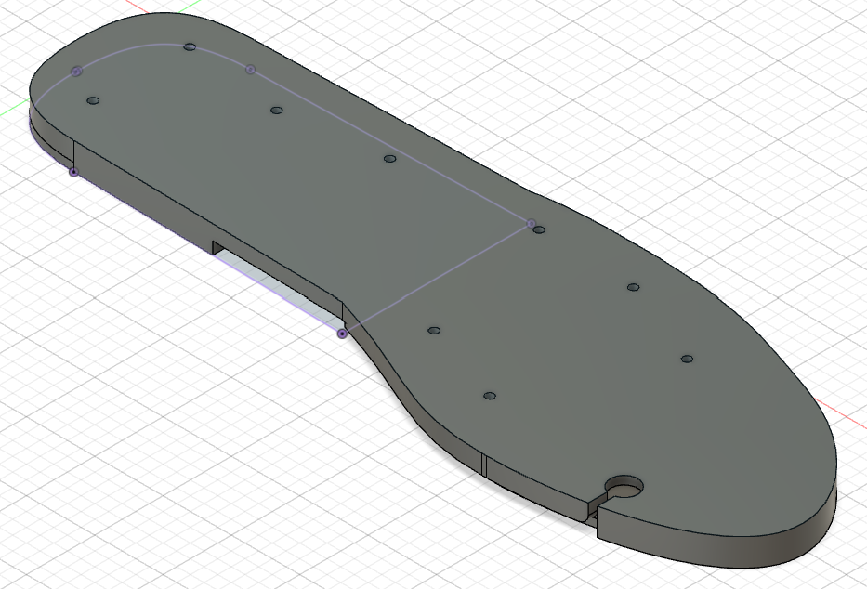
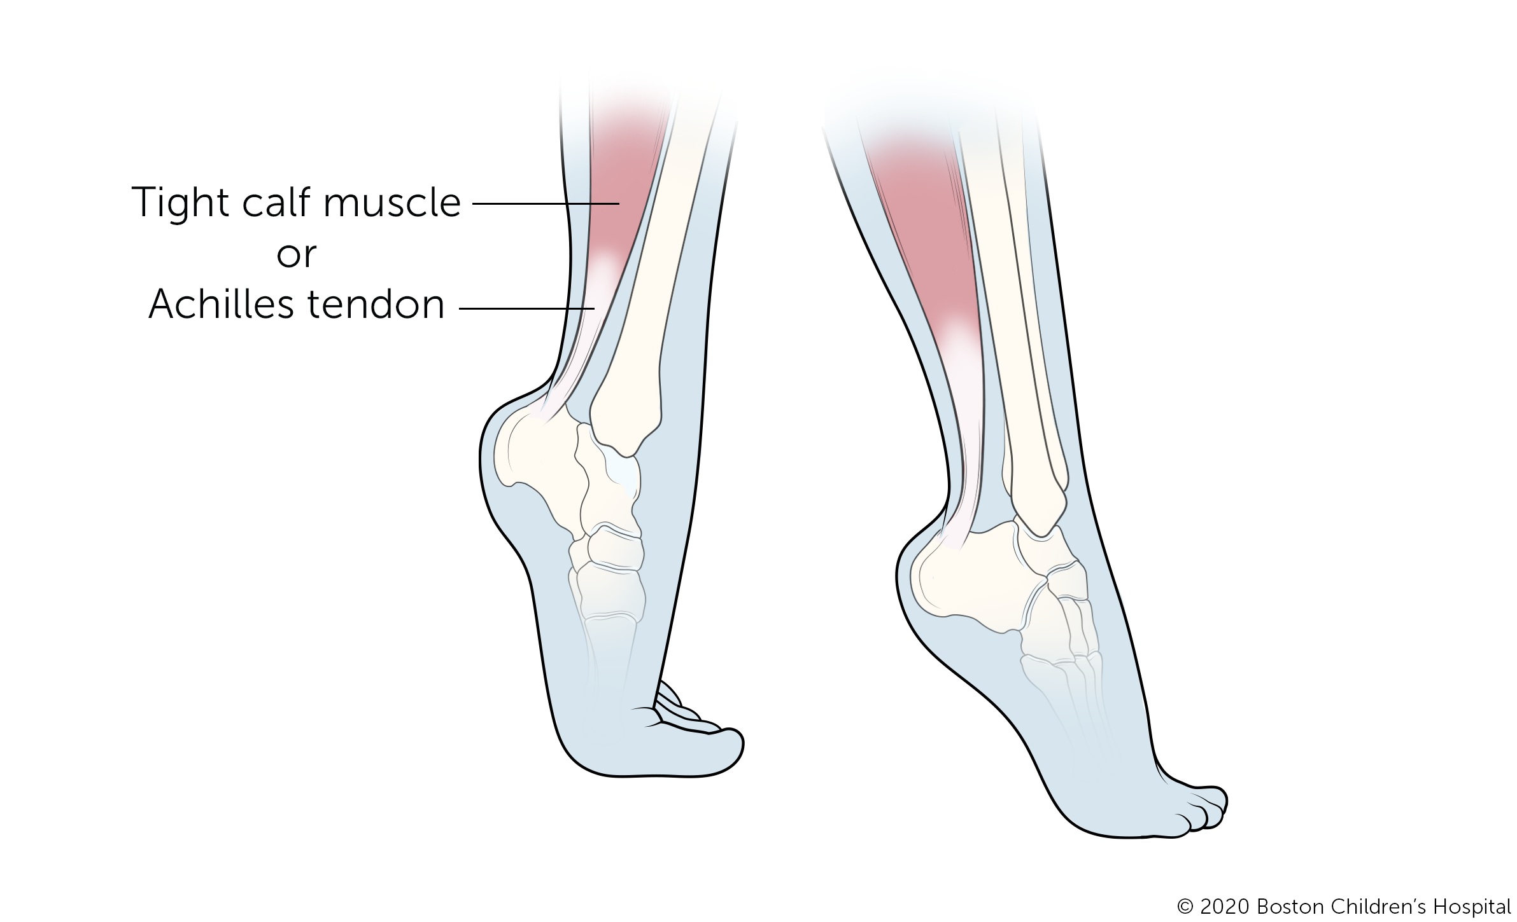
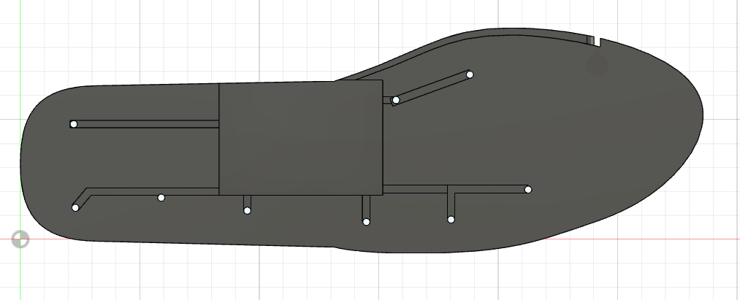
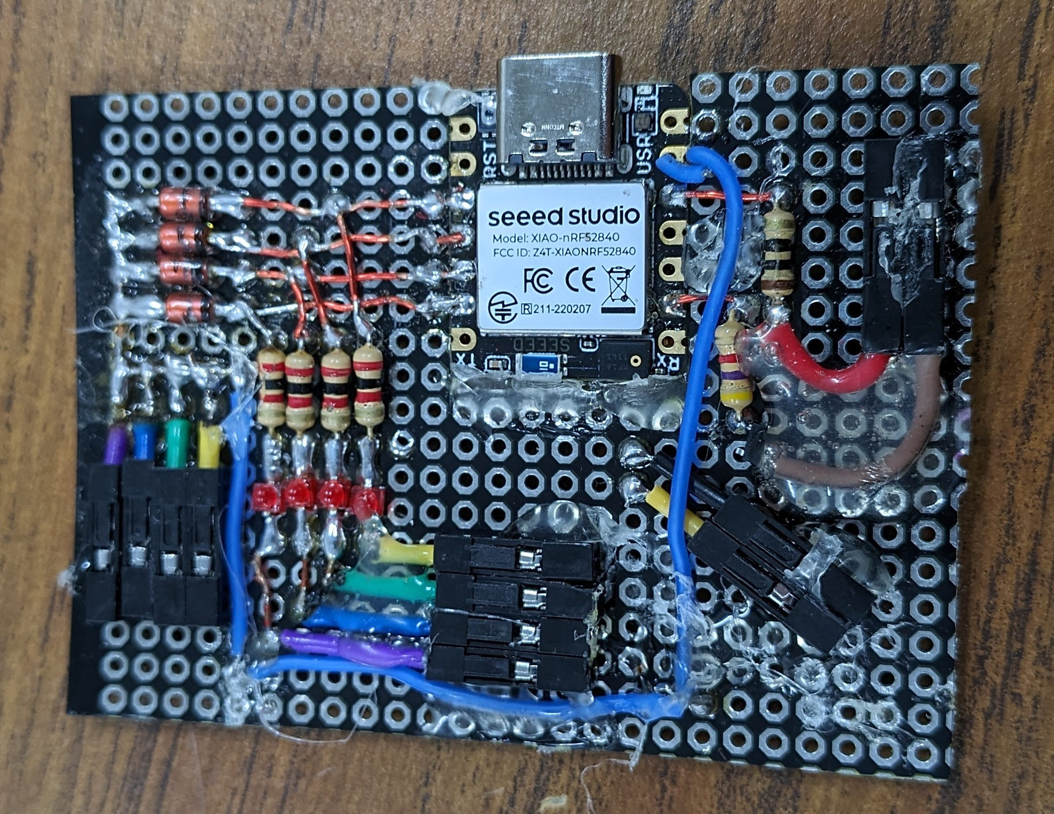
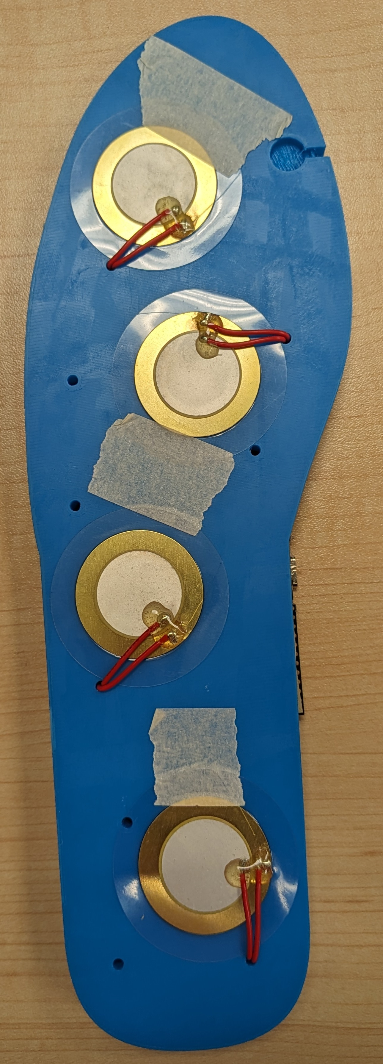
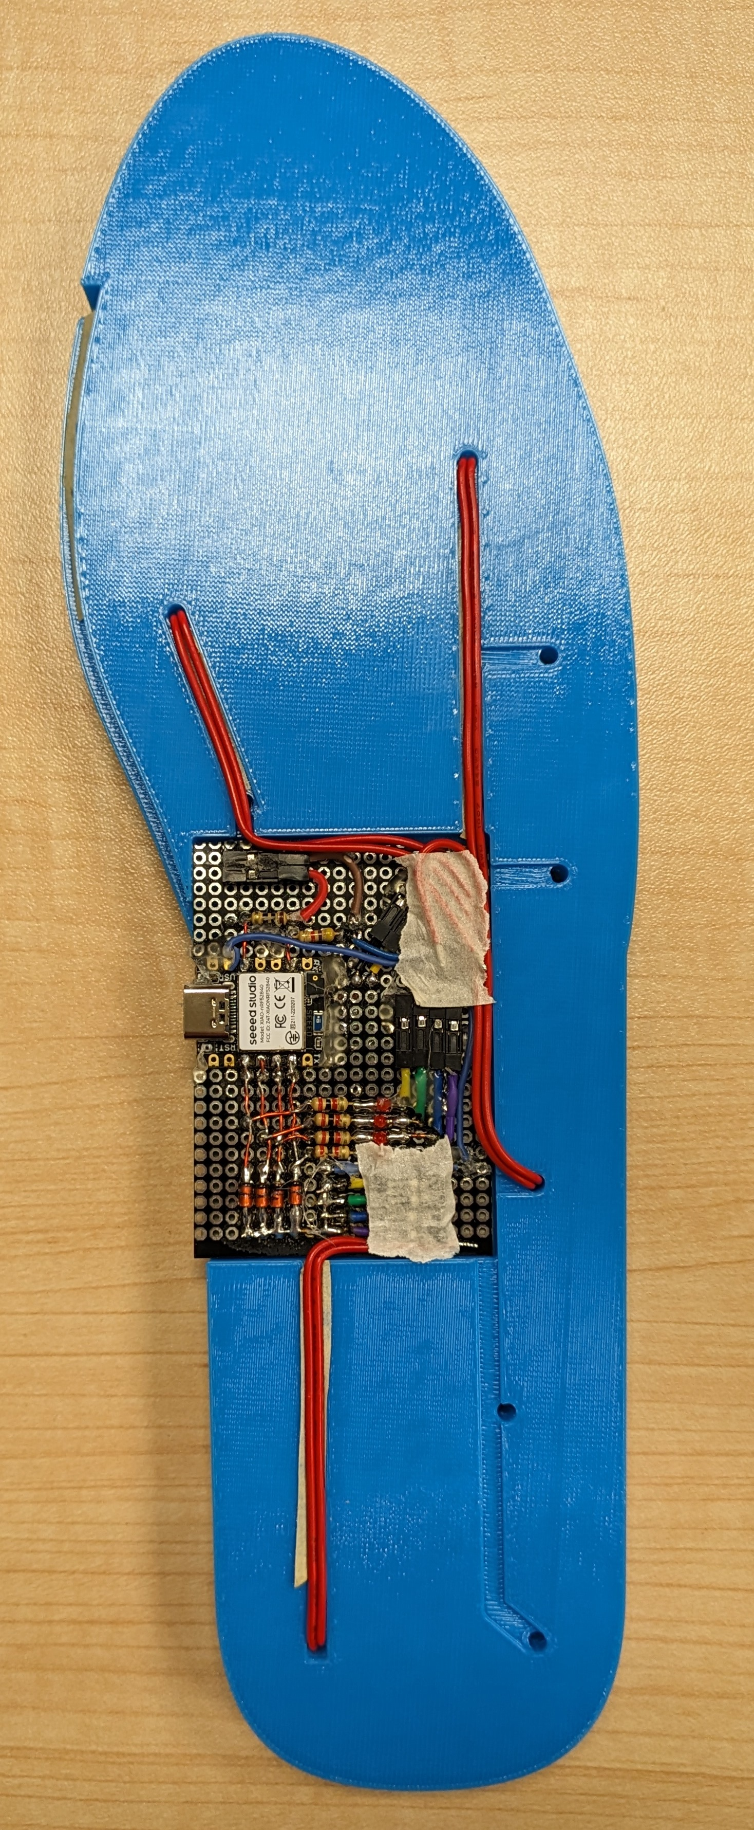
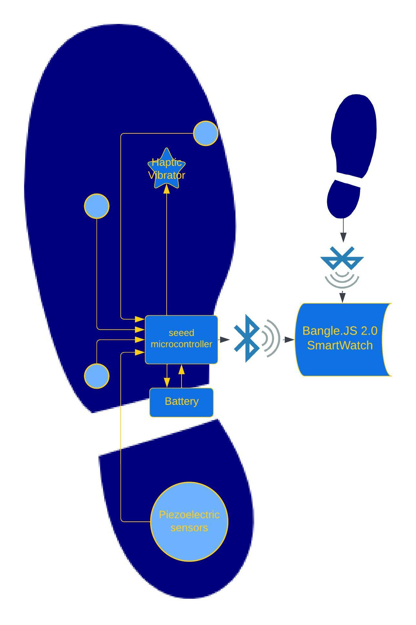
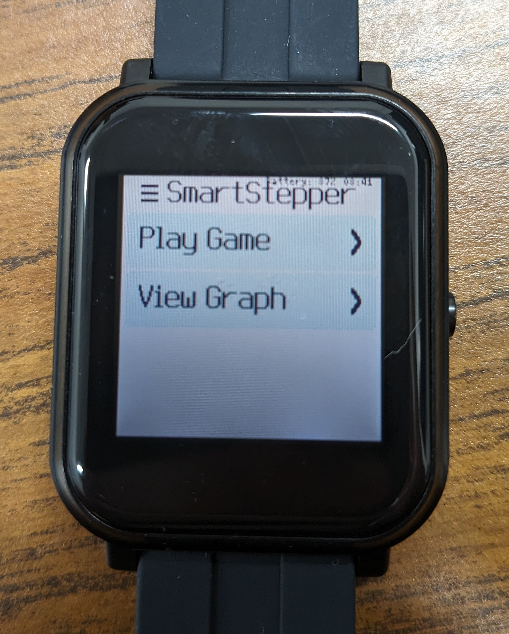
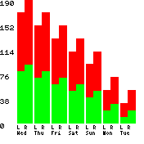
SmartStepper With Biofeedback for Toe-Walkers
May 2024
Embedded Systems Engineering Technology
Cari Blaker, Ismael HernandezHernandez, Zachary Elliott, Ian Gaffney
Cari
Ismael
Zach
Ian
Introduction
Method
Conclusions
What is toe-walking?
Bilateral toe-to-toe gait pattern with no heel strike
Affects ~5% of the population
Creates balance and functional limitations
The two current solution options—ankle/foot orthotics and surgery—have both proven to be ineffective.
Two custom 3D-printed TPU insoles each house:
One seeed board microcontroller
Four piezoelectric sensors
A rechargeable battery
A haptic vibrator
The SmartStepper achieved all of its objectives. The main improvements that could be made:
Data collection is the biggest hurdle for ensuring accuracy of sensor input. Without long-term testing, high accuracy of step detection is out of range.
The current game is "Flappy Bird," which may not be marketable
The microcontrollers:
Process sensor input as "good"/"bad" steps
activate the haptic vibrator in real-time response to "bad" steps
Transmit step information via Bluetooth LE to a Bangle.JS 2.0 SmartWatch
Objectives
To help toe-walkers correct their gait and prevent further functional limitations, the SmartStepper aims to accomplish these goals:
Insoles detect toe- vs. heel-strikes
Provide feedback to correct gait pattern
Camouflage use of the system
Encouragement to heel-strike
The custom SmartWatch operating system:
Displays a graph of the week's good/bad steps (with semi-live updates)
Provides a game to encourage improvement and practice, by allowing extra "lives" for more steps/better ratios
Next "Steps"
Flexible Lithium Ceramic Battery (FLCB)
Further game customization
Phone App (iOS & Android)
Data collection and testing, to increase reliability and accuracy
Incorporate seeed board IMU for market extension beyond toe-walking
Comparison with SmartWatch pedometer count
Acknowledgements
Thank you to Dr. Marybeth Grant-Beuttler and Prodigy Health Innovations for funding and providing product requirements

